Slide 1



Let’s Steal Some Seats!
Deal Velocity
Jason Owen
CEO
+447962608880
jason.owen@theblackchair.com

Slide 2

Clarity Service = Compelling Evidence to Win!
Pre-sales, Pre-design, Pre-migration

Slide 3
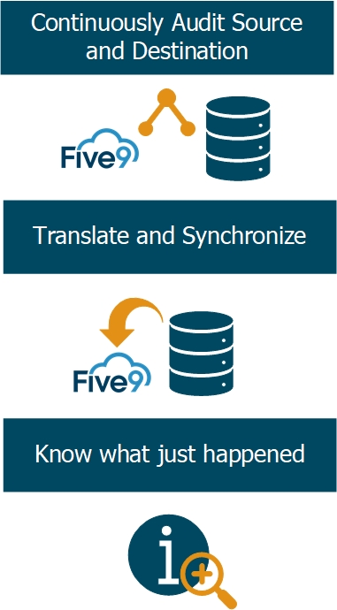
Assurance = De-Risk the Migration = Confidence
Migrate with Quality and Velocity

Slide 4
Five9 Use Case – LogistiCare and FedEx
Clarity Use case: Seat Stealing LogistiCare; 3500 agent Avaya CX platform
What: Customer ran an RFP with leading CCaaS vendors (NiC, Genesys Cloud, Ujet & Five9).
The Problem: The prospect did not understand the “how” of the migration project. They did not feel confident they had their arms around what they had and how they were currently using it. They wanted to reduce project exposure the people who built the original solution were long departed. They want to use automation where possible to get the job done.
The Solution: Five9 proposed a “Clarity” engagement to catalog and continuously audit the live technical status, business behaviors and change activity of their Avaya estate for a period of 60 days.
The Outcome: The prospect gain Deal Winning confidence! Five9 PS and LogistiCare could discuss a transformation design in contrast to Legacy AVAYA. Guiding them not to LIFT AND SHIFT! That their old reports and design is NOT FIT FOR PURPOSE!
Assurance Use case: FedEx was 4500 Cisco agents with the right skill and in their groups migrated over one night into Five9 automatically. Look, No hands! No Errors. No Stress!

Slide 5


Let's Steal Seats!

